Slide 1
Just in Time Presentation
By Bryce, Brian, Kesang, and Jack

Slide 2

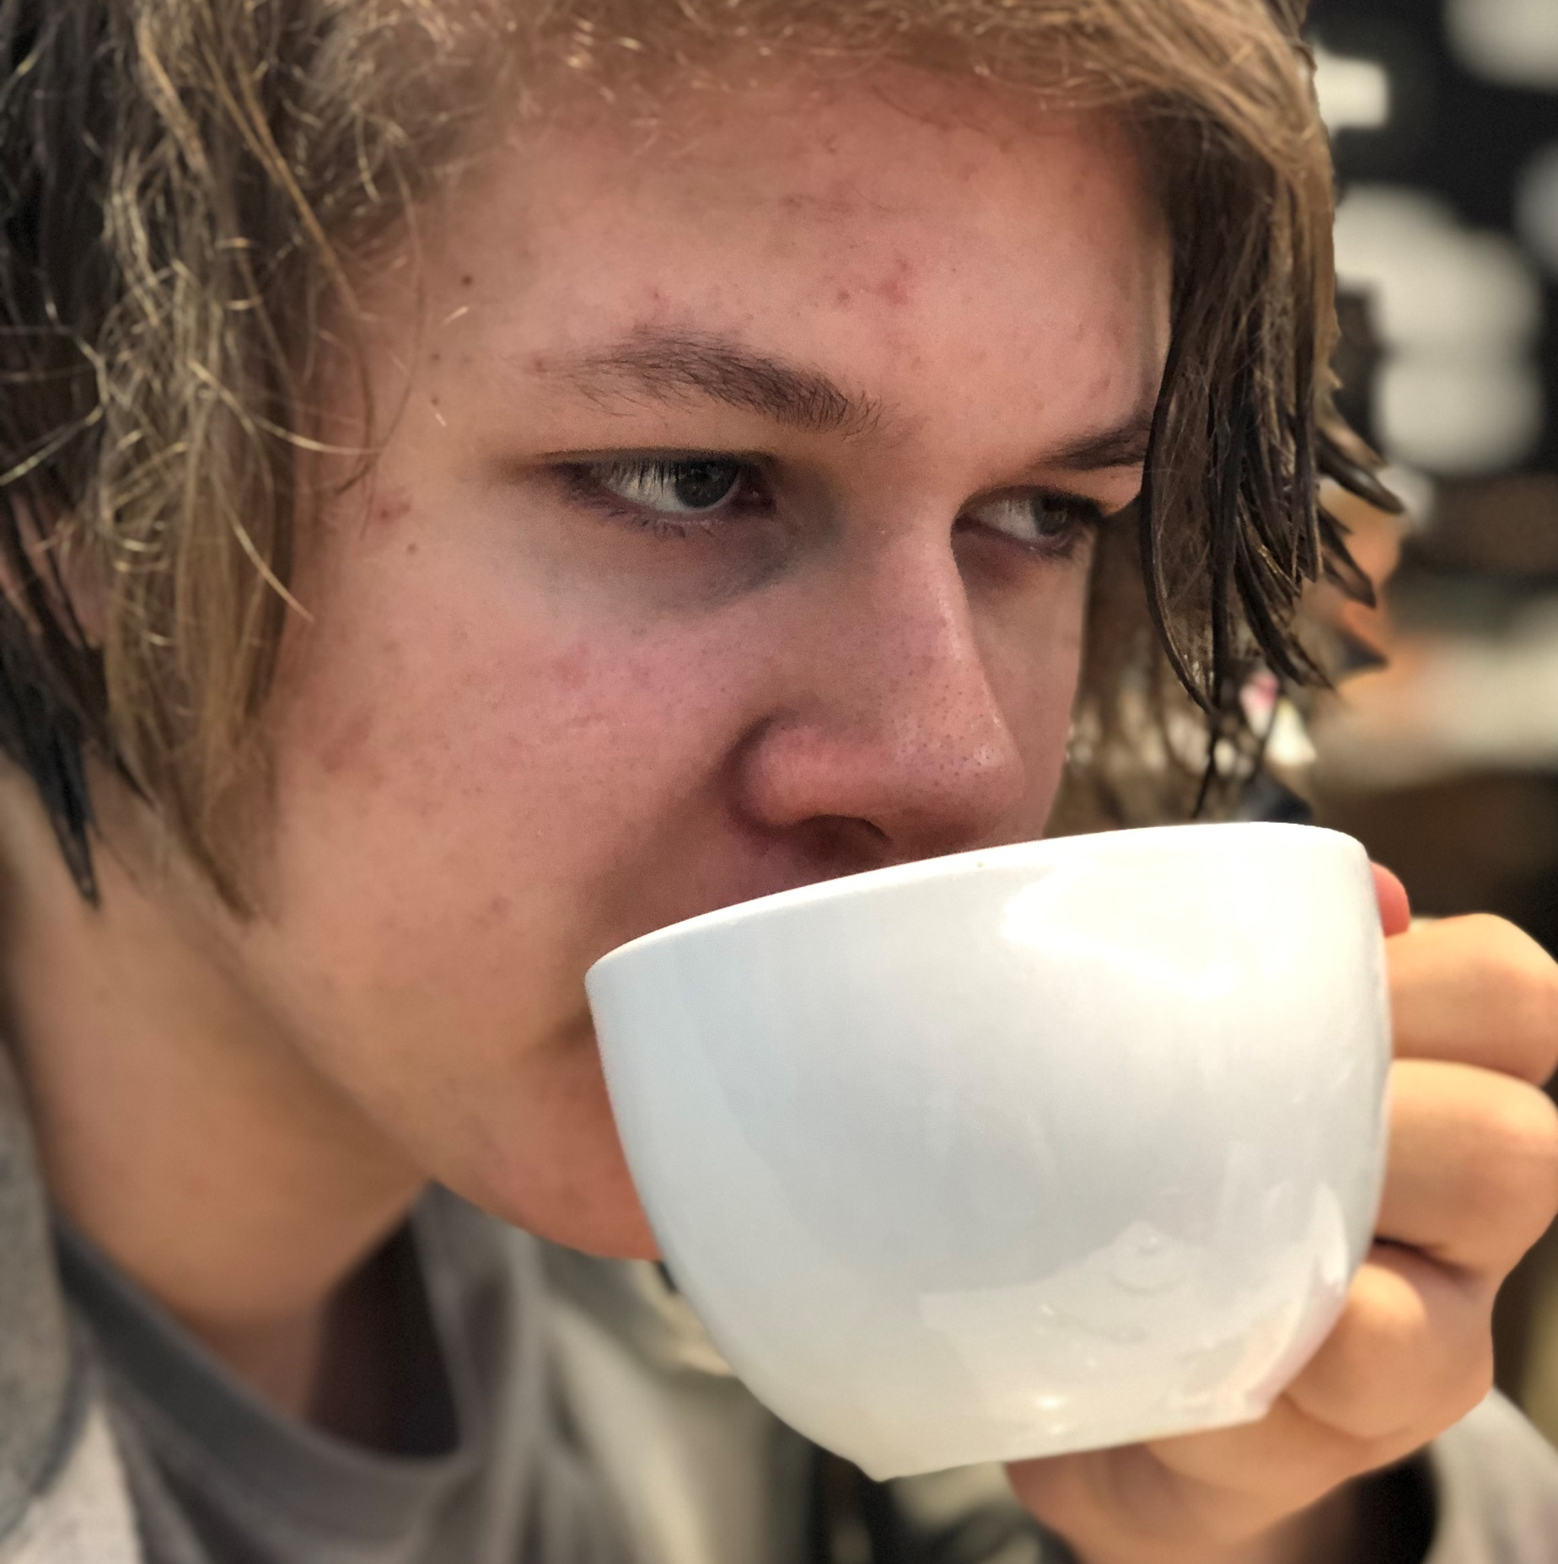
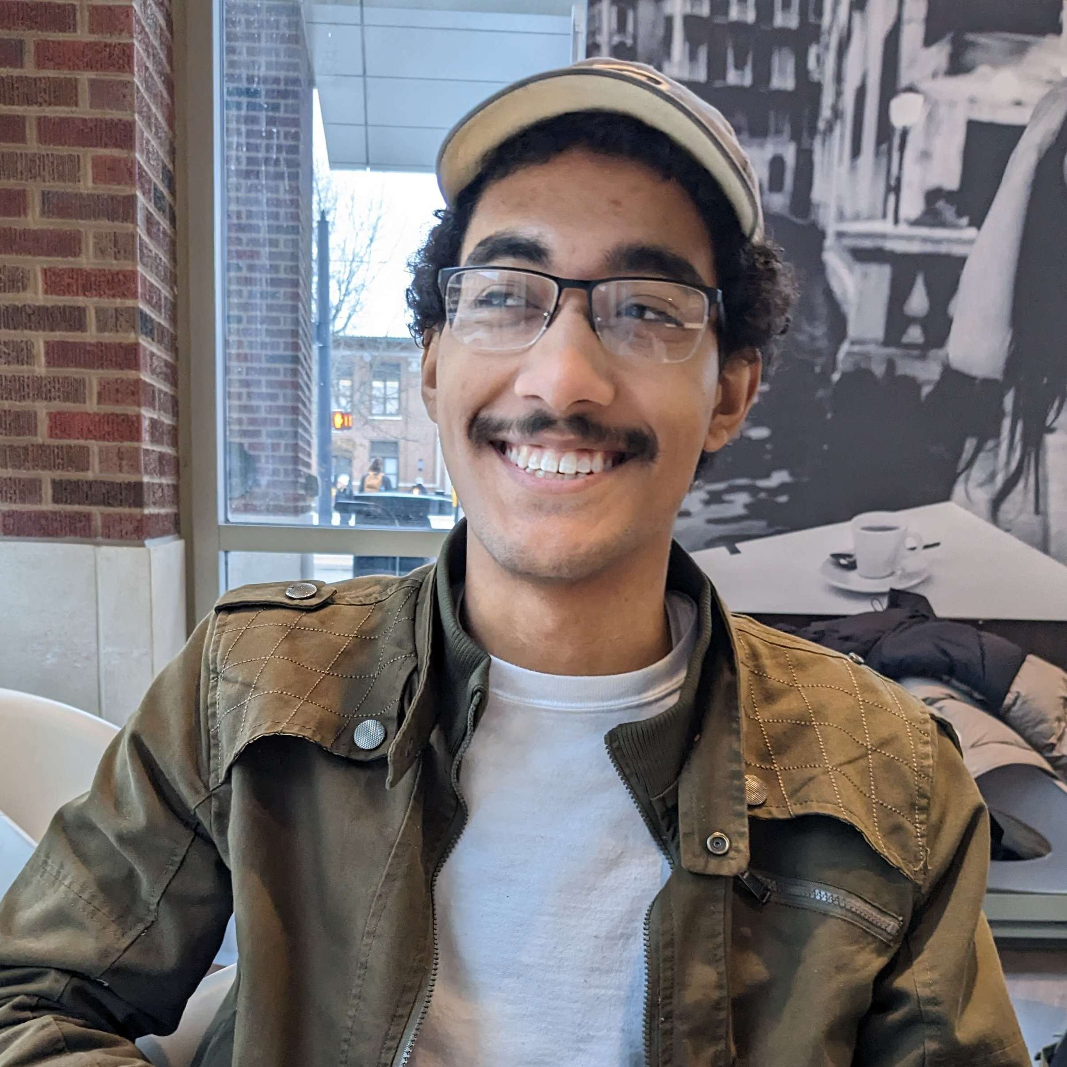
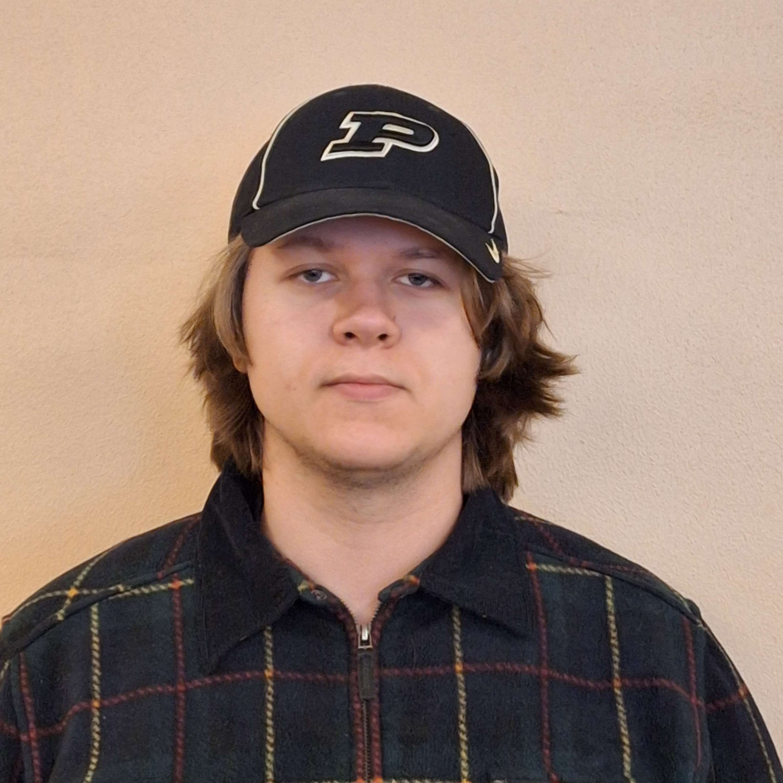
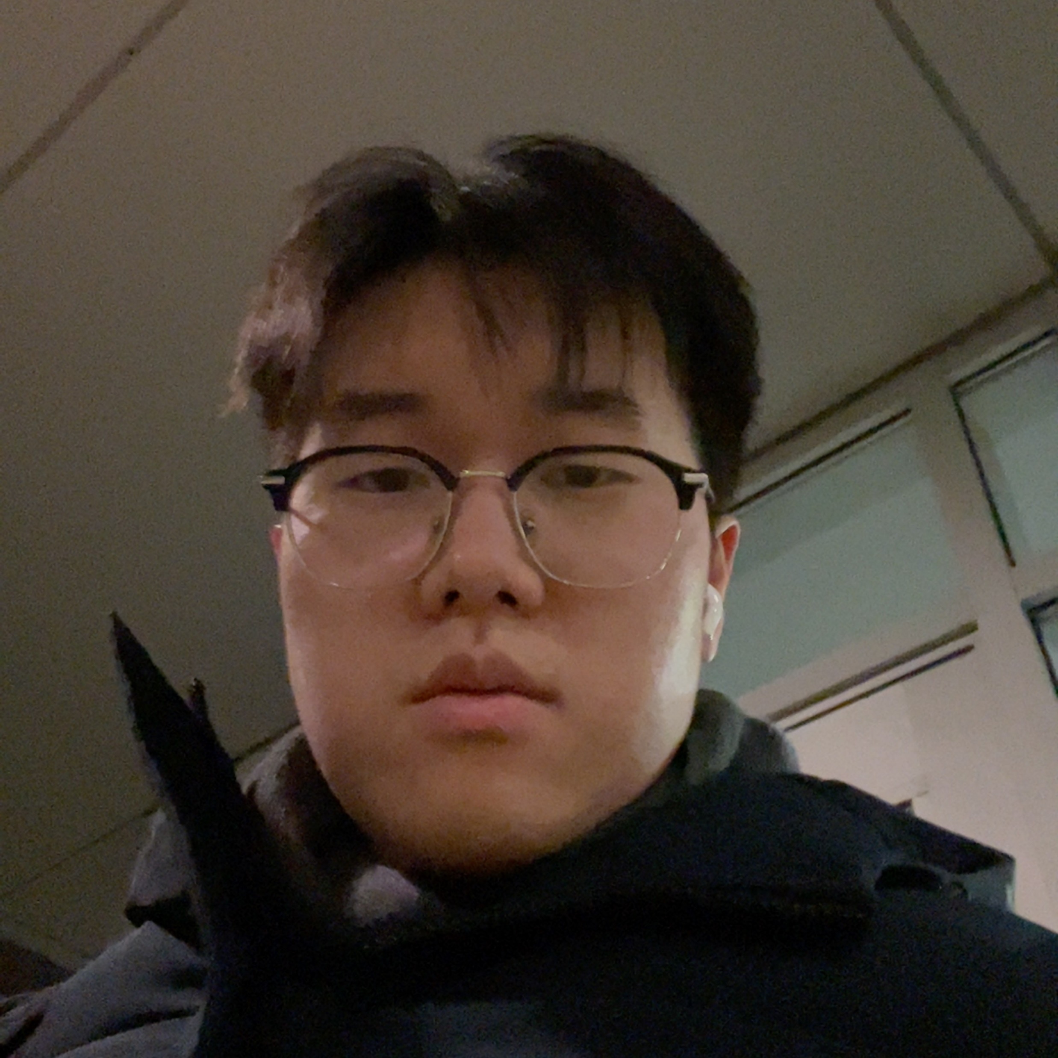
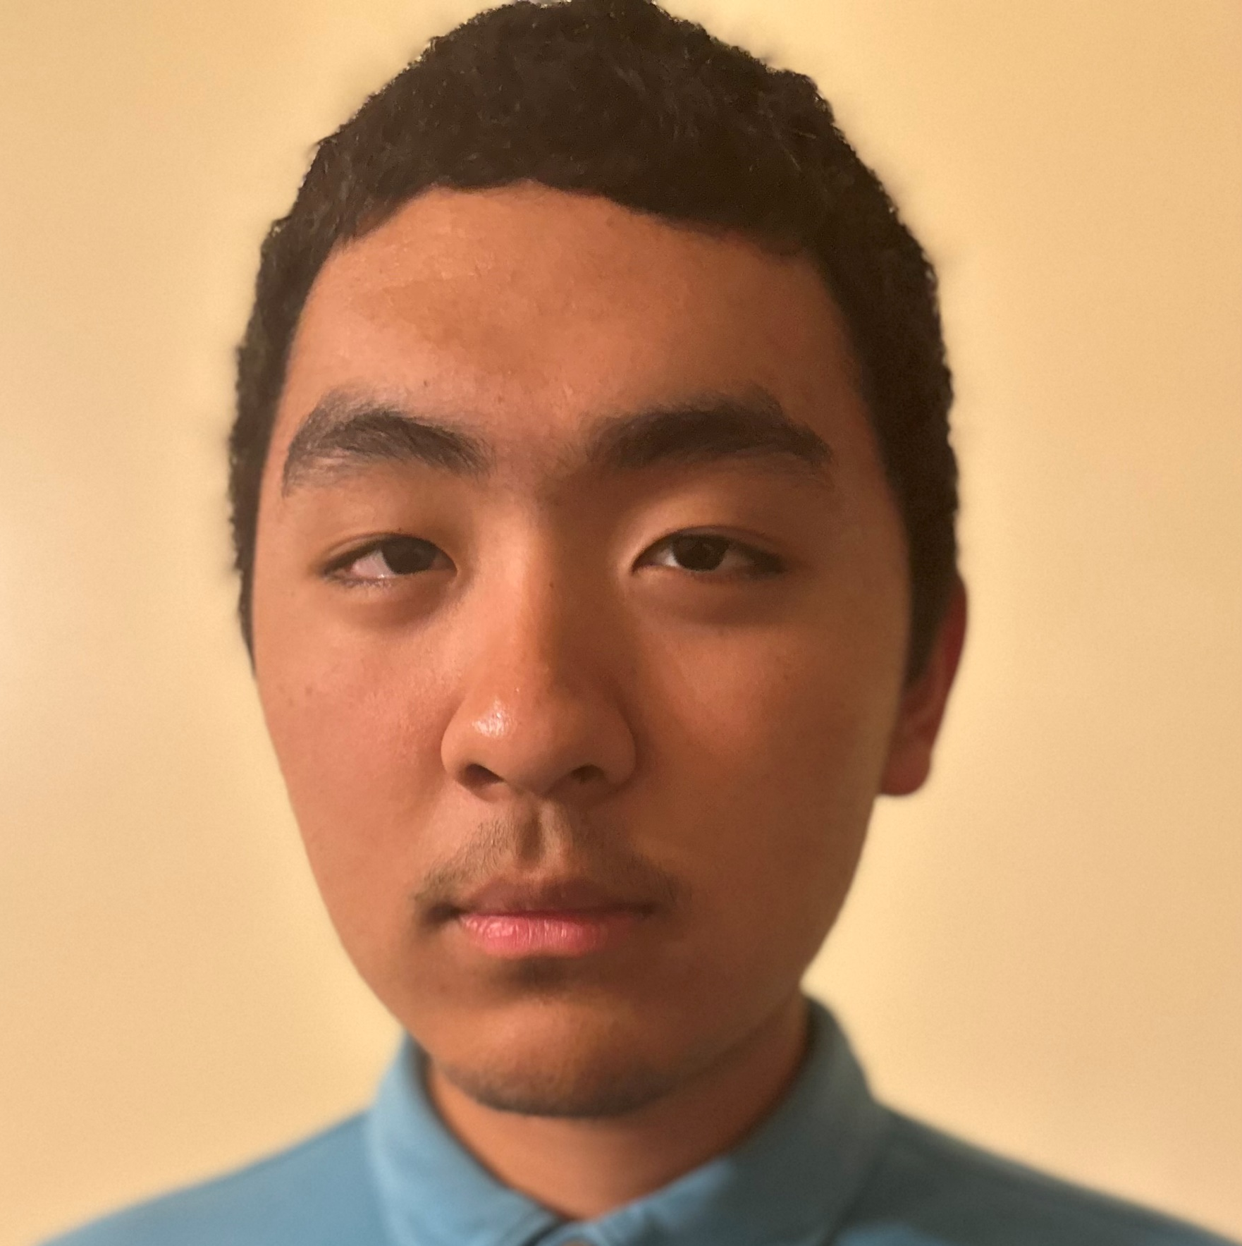
Team Shino
Our Team
Bryce Stanisz
Brian Kim
Kesang Sherpa
J. “Jack” Reed
Our Goal
Create a game through our website sufficient enough to be put on our portfolio

Slide 3

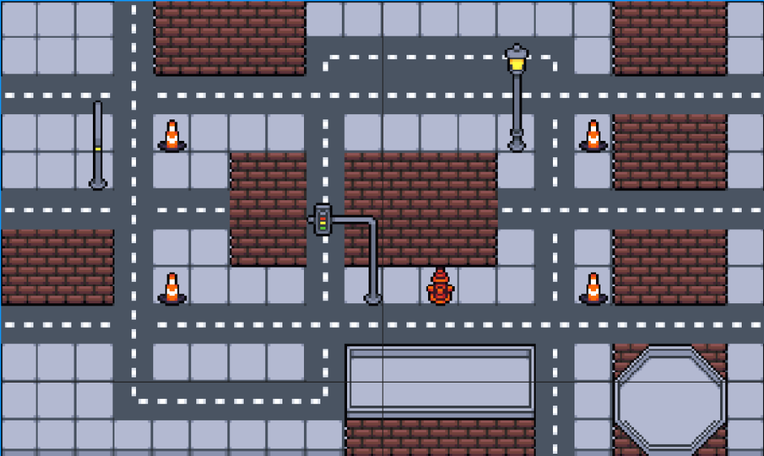


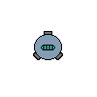
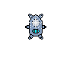


Cyber Swarm

Slide 4
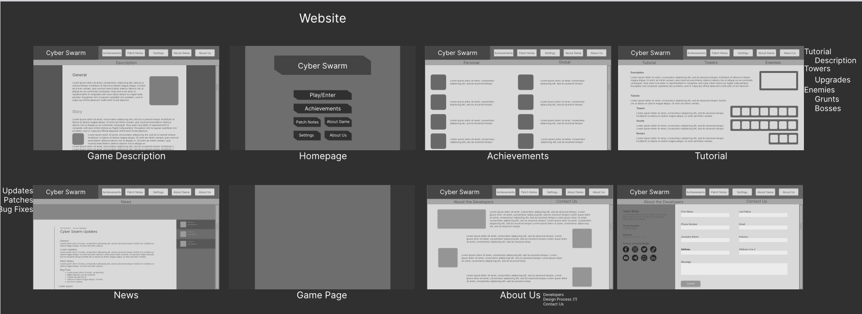
Our Mockup 1: The Website

Slide 5
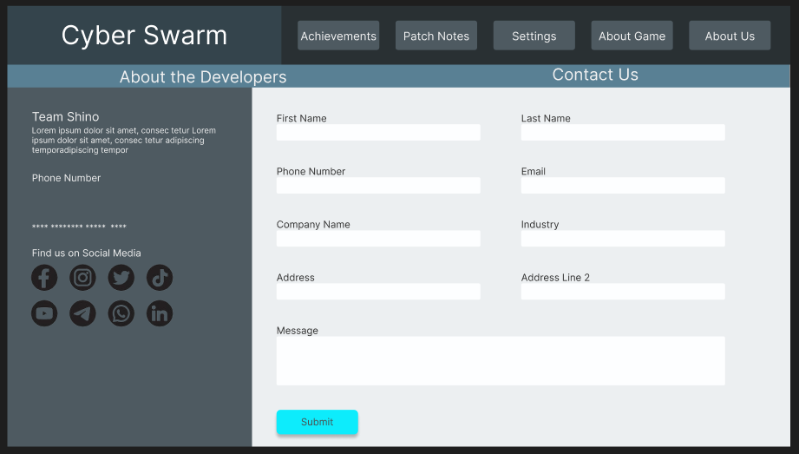
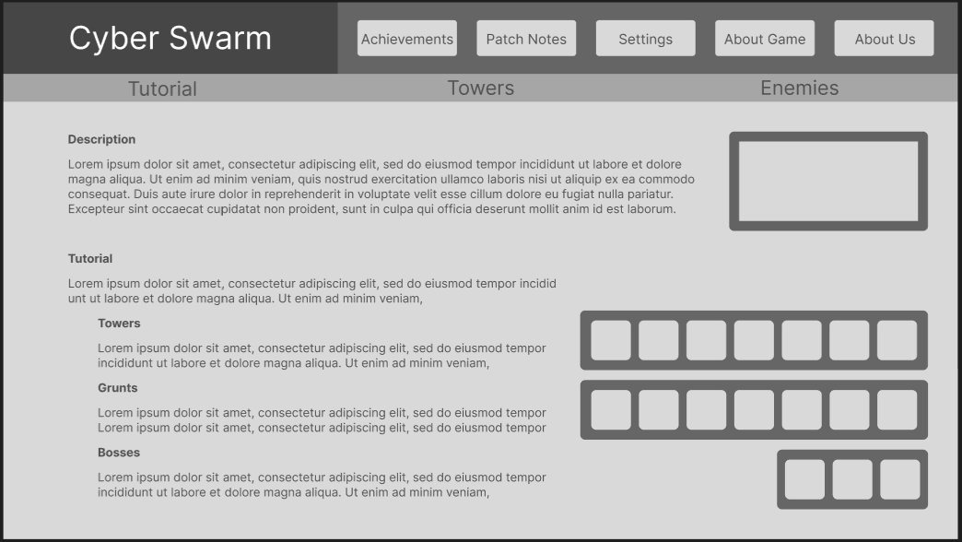
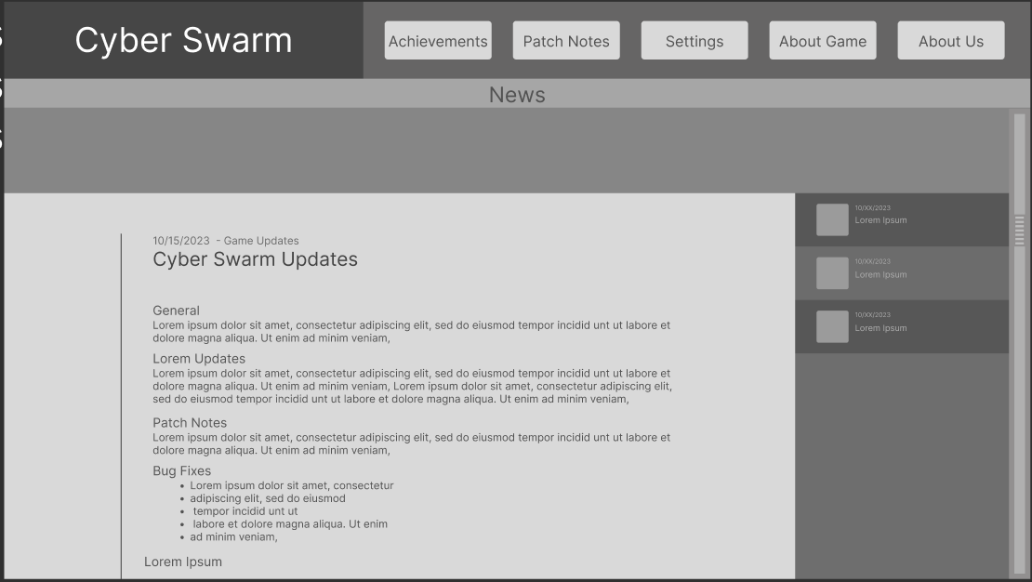
Our Mockup 1: The Website
Our Color Scheme
Example 1
Example 2

Slide 6
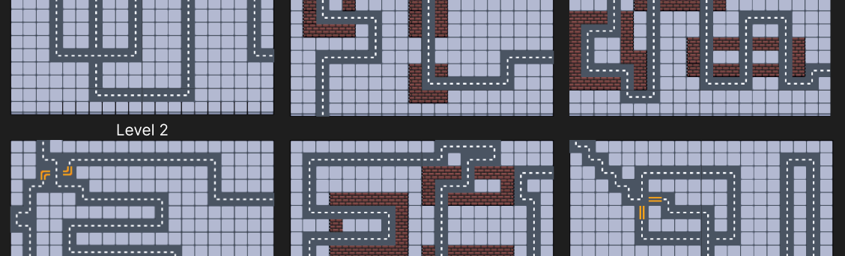
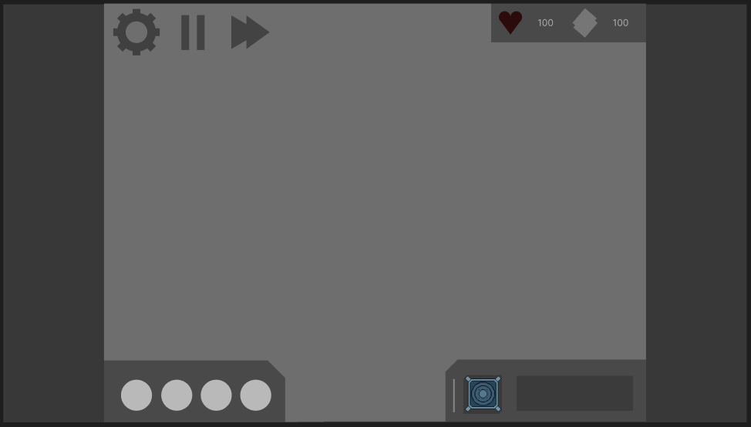
Our Mockup 2: The Map and UI
User Interface

Slide 7



Our Mockup 3: Turrets
Basic Turret
Fire Turret
Liquid Nitrogen Turret
Command Center
Mining Tower
Missile Turret

Slide 8






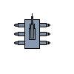


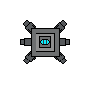
Our Mockup 3: Enemies
Basic Enemies
Camo Enemies
Fast Enemies
Other Enemies
Big Enemies
Armored Enemies

Slide 9
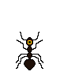


Our Mockup 3: Bosses
Ant Queen
Mechanical Water Bug
The Robot Leader

Slide 10
Our Progress
What we’ve done
Finished concept designs
Maps/levels, User Interface, Towers, Enemies, Bosses, or any other essential assets
Mostly finished our website. Made certain pages responsive
Outlined our coding framework, and begun coding in JavaScript
What we have left
Polish the website and make it completely responsive
Code the game itself
User Interface, levels, placing towers, game mechanics, etc.

Slide 11
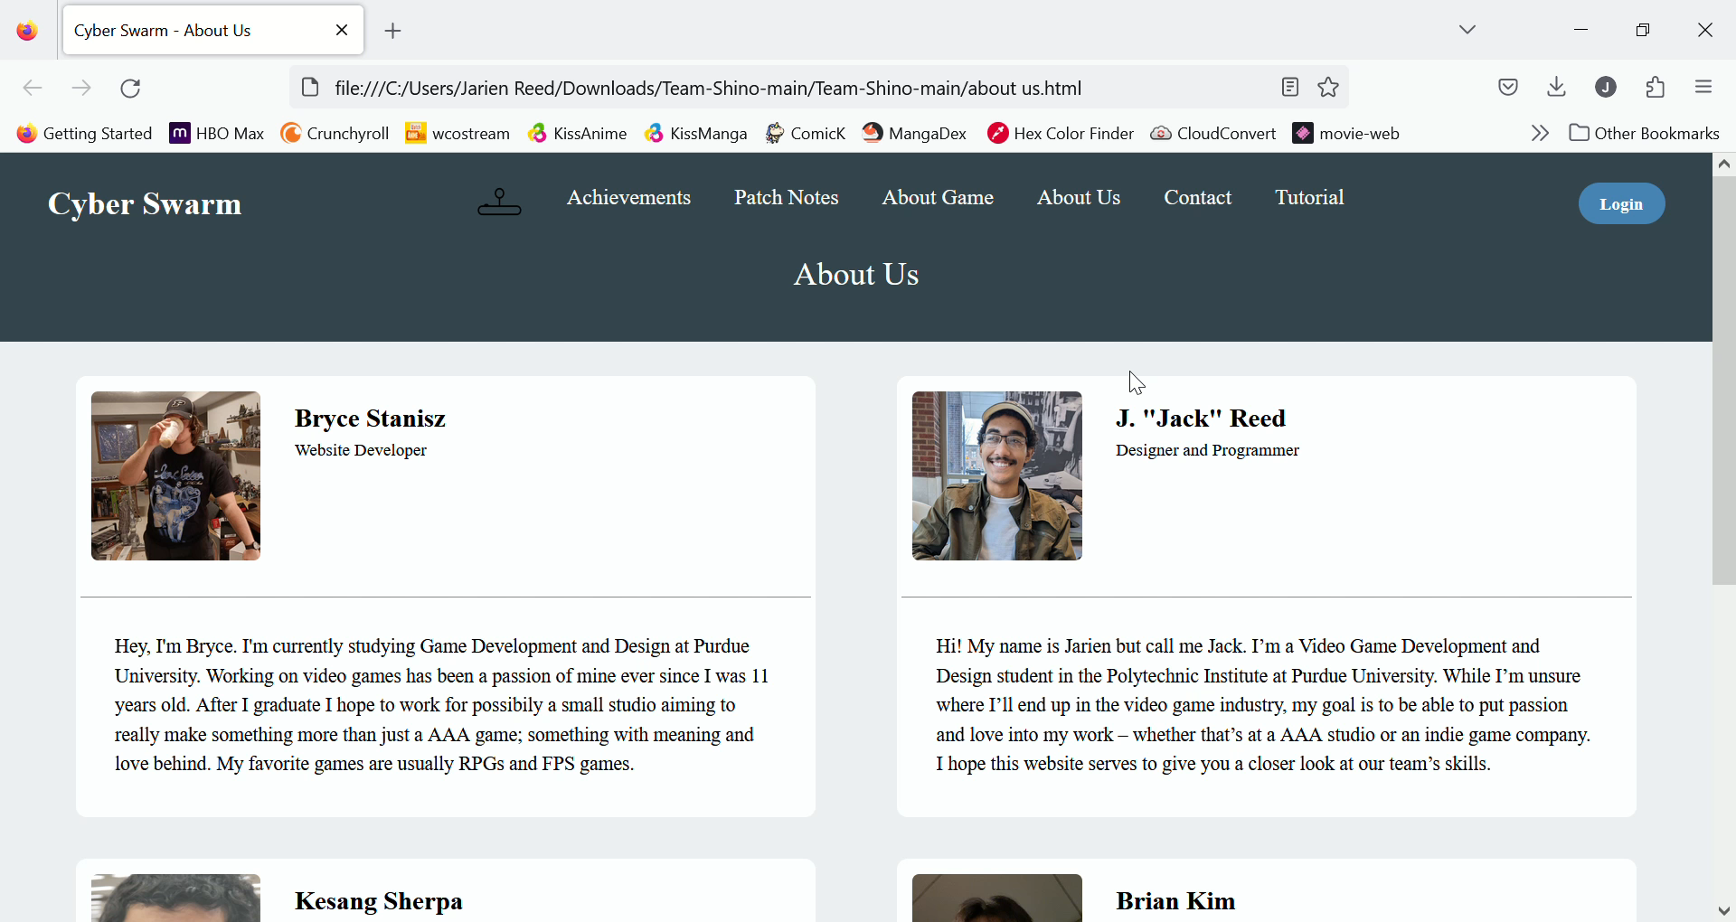
Our Progress 2: Demo
Link to pc video demo
https://youtu.be/ooAQ5PVC0EA

Slide 12
Thank you for your time
Thank You
Thank You

